Slide 1
Step-By-Step Overview of the
FY 2018 Household Report
LIHEAP Webinar hosted by the Office of Community Services (OCS) in the Administration for Families and Children (ACF) presented by APPRISE under contract to OCS
November 15, 2018
Welcome:
Vikki Pretlow (OCS Staff)
Presenters:
Dan Bausch (APPRISE)
Grace Rehaut (APPRISE)

Slide 2
Welcome
  Purpose of This Webinar
    To provide an introduction to the Household Report – Long Form.
    To furnish an in-depth overview of the FY 2018 Household Report, including a line-by-line review of each reporting item and instruction.
    To highlight key reminders and ways to avoid common reporting issues.
  Audience for This Webinar
    New LIHEAP Coordinators and staff who have not worked on completing the Household Report - Long Form.
    Experienced LIHEAP Coordinators and staff that would like to review the requirements in detail to understand al of the instructions and avoid reporting issues.
Presenter(s):
Vikki Pretlow

Slide 3
Household Report Training
What if I am familiar with the Household Report?
This is the second of three webinars on completing the FY 2018 Household Report.
  Upcoming Additional Webinars:
    Webinar #3: Final Reminders Webinar – December 2018
      This 30-minute webinar will provide brief reminders and updates on the FY 2018 Household Report.
      This is intended for experienced Coordinators and staff.
      This webinar will be similar to the first webinar conducted in October.
Presenter(s):
Vikki Pretlow

Slide 4
Webinar Overview
  Structure of The Webinar
    90 minutes to review key information.
    Slides available for download now under “Handouts” in the GoToWebinar Sidebar.
    The webinar is being recorded and will be published on the ACF YouTube channel.
  Have a question?
    You are encouraged to ask questions as you have them by typing them into the GoToWebinar “Question” box.
    Submitted questions will be reviewed and responded to at the question breaks or via an e-mail from APPRISE.
    You can also click the “raise your hand” button during a break to be called on to ask a question over the phone.
Presenter(s):
Dan Bausch

Slide 5
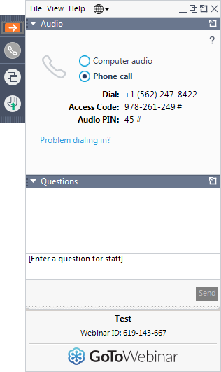

GoToWebinar Question Box
If the sidebar is minimized, it will look like this:
Enter text here to ask a question.
Click this button to expand sidebar.
Presenter(s):
Melissa Torgerson

Slide 6
Basics of the Household Report

Slide 7
Overview of the Household Report
History and Purpose
  The Household Report is an annual report that grantees must submit to HHS.
  The Household Report has been submitted by grantees since the 1980s.
  The Report allows OCS to report information to Congress about LIHEAP outcomes, as required by the statute.
  Data are…
    Published in the annual LIHEAP Report to Congress
    Published in the LIHEAP Data Warehouse
    Used to respond to Congressional and White House inquiries.
Presenter(s):
Grace Rehaut

Slide 8
Overview of the Household Report
Data and Requirements
  Two main types of data need to be reported:
    Information on households that received LIHEAP assistance
    Information on households that applied for LIHEAP assistance.
  Two versions of the Report:
    a Long Form for state & select territory grantees
    a Short Form for tribal grantees.
  When is it due?
    Grantees must submit preliminary data in September as part of their application for LIHEAP funds. Data can be estimated.
    Grantees must submit final non-estimated data by the specified due date (generally in December).
Presenter(s):
Grace Rehaut

Slide 9
Overview of the Household Report
Relation to Other Reports
  The Model Plan indicates the types of LIHEAP assistance you intend to provide during the upcoming fiscal year.
  After the fiscal year is complete…
    The Household Report is for reporting the count of households that were assisted or applied for each type of LIHEAP assistance during the past fiscal year.
    The Performance Data Form - Module 1 (Grantee Survey) is for reporting on the sources of LIHEAP funds, the uses of LIHEAP funds during the past fiscal year, and the average benefit amount provided.
    The Performance Data Form – Module 2 (Performance Measures) is for reporting on the energy burden of assisted households and the number of occurrences where LIHEAP maintained or restored home energy service during the past fiscal year.
Presenter(s):
Grace Rehaut

Slide 10
Update on the FY 2018 Report
Status & Due Date
  Approval for the Household Report form expired on October 31st. The Office of Management and Budget (OMB) is currently reviewing a request to renew the Household Report for three more years.
  OMB is expected to approve the renewal of the Household Report in December.
  Upon approval by OMB, HHS will publish an Action Transmittal with the final due date and instructions for accessing and submitting the form in OLDC.
  Grantees are encouraged to prepare their final data for submission in anticipation of a December due date.
Presenter(s):
Grace Rehaut

Slide 11
FY 2018 Household Report:
What Has Changed from Last Year?
  There are no changes to the FY 2018 Household Report. The requirements remain the same as those for last year’s FY 2017 Report.
  Grantees can review last year’s instructions for reporting each item in the Household Report – Long Form:
    https://www.acf.hhs.gov/sites/default/files/ocs/liheap_at_2018_2_attachment_a_fy_17_hhrp_tinstructions_long_form.pdf
  Grantees are also encouraged to review issues identified during the prior year review.
Presenter(s):
Grace Rehaut

Slide 12
Reporting Rules for the Household Report

Slide 13
Rules for Reporting
Grantees are expected to…
  Report data according to the official instructions
  Explain any unique program features or nuances in the “Notes” section.
  Provide a consistent report with final data.
  Investigate and address issues or questions from the review of your report in a timely fashion.
Presenter(s):
Dan Bausch

Slide 14
Overview of Reporting Rules
#1 – Report According to the Instructions
  LIHEAP is a block grant, giving grantees the freedom to design unique and diverse programs.
  OCS must report consistent information to Congress. The Household Report allows OCS to report uniform information on households that receive LIHEAP assistance.
  Grantees should…
    Review the instructions for guidance on how to correctly report each item.
    Contact their OCS liaison when encountering challenges in reporting according to the instructions.
Presenter(s):
Dan Bausch

Slide 15
Overview of Reporting Rules
#1 – Report According to the Instructions
  Examples:
    A grantee may have a program year that differs from the federal fiscal year (October 1 to September 30). However, all grantees are instructed to report information in the Household Report corresponding to the federal fiscal year.
    Grantees may have reporting systems designed to report the count of individual benefits provided. However, all grantees are instructed to report information in the Household Report on the number of households served, rather than the number of benefits issued.
Presenter(s):
Dan Bausch

Slide 16
Overview of Reporting Rules
#2 - Explain Unique Program Features/Nuances
  The Household Report includes a Notes section to allow grantees to explain any reported information that is out of the ordinary, generates a warning in OLDC, or requires clarification.
  If there is anything about your program operation that requires explanation to explain your Household Report data, please add a note in the Notes section.
  Notes allow for an accurate understanding of your reported data and OCS uses these notes in tables and footnotes in the annual Report to Congress.
Presenter(s):
Dan Bausch

Slide 17
Overview of Reporting Rules
#2 - Explain Unique Program Features/Nuances
  Examples:
    A grantee reports the same number of households served with Heating Assistance and served with “Any Type of LIHEAP Assistance” because the grantee always provides heating assistance prior to other types of assistance. For the Household Report, the grantee should include a note to indicate this.
    A grantee receives a Warning message in OLDC alerting them that the number of households they reported for Cooling Assistance is substantially different from the prior year. If the grantee confirms the data are correct, the grantee should provide an explanation for this difference in the Notes Section.
Presenter(s):
Dan Bausch

Slide 18
Overview of Reporting Rules
#3 – Provide a Consistent Report with Final Data
  The Household Report requires grantees to report using the best information available at the time of reporting.
  To meet the reporting requirements, grantees need to use their data reporting system to identify and count households for each reporting item using data tracking systems and program records.
  OCS provides data validation and checks to assist grantees with reporting:
    OLDC Warning and Error Messages
    APPRISE Review
Presenter(s):
Dan Bausch

Slide 19
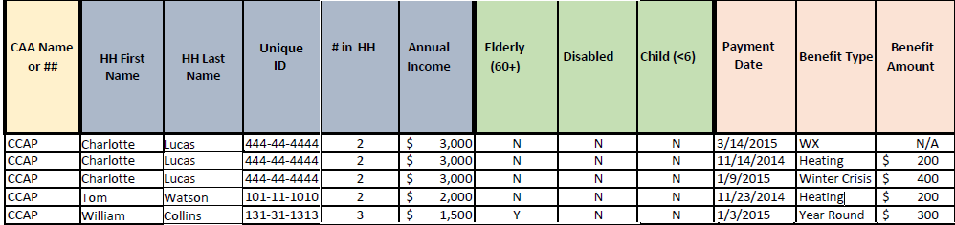
Overview of Reporting Rules
#3 – Provide a Consistent Report with Final Data
  Example of Data Reporting System for the Household Report
Presenter(s):
Dan Bausch

Slide 20
Overview of Reporting Rules
#4 – Investigate/address issues or questions
  If issues or questions are found during the review of a grantees report, OCS expects the following:
    The grantee is expected to be able to verify their data by reviewing their data query, processing programs, or data files.
    The grantee should correct issues or to furnish a note on issues that cannot be resolved for the current report
    Grantees should respond to questions and make updates to their report in a timely fashion.
  Grantees should be able to verify and confirm each item they report using their reporting documentation (queries, internal reports, etc.).
Presenter(s):
Dan Bausch

Slide 21
Section I:
Number of Assisted Households

Slide 22
Overview of Section I
Report the unduplicated number of households that received LIHEAP assistance for…
  Each Type of LIHEAP Assistance (Lines 1 to 4)
  Any Type of LIHEAP Assistance (Line 5)
  Bill Payment Assistance (Line 6)
  Nominal Payments for SNAP Partnership (Line 7)
Presenter(s):
Dan Bausch

Slide 23
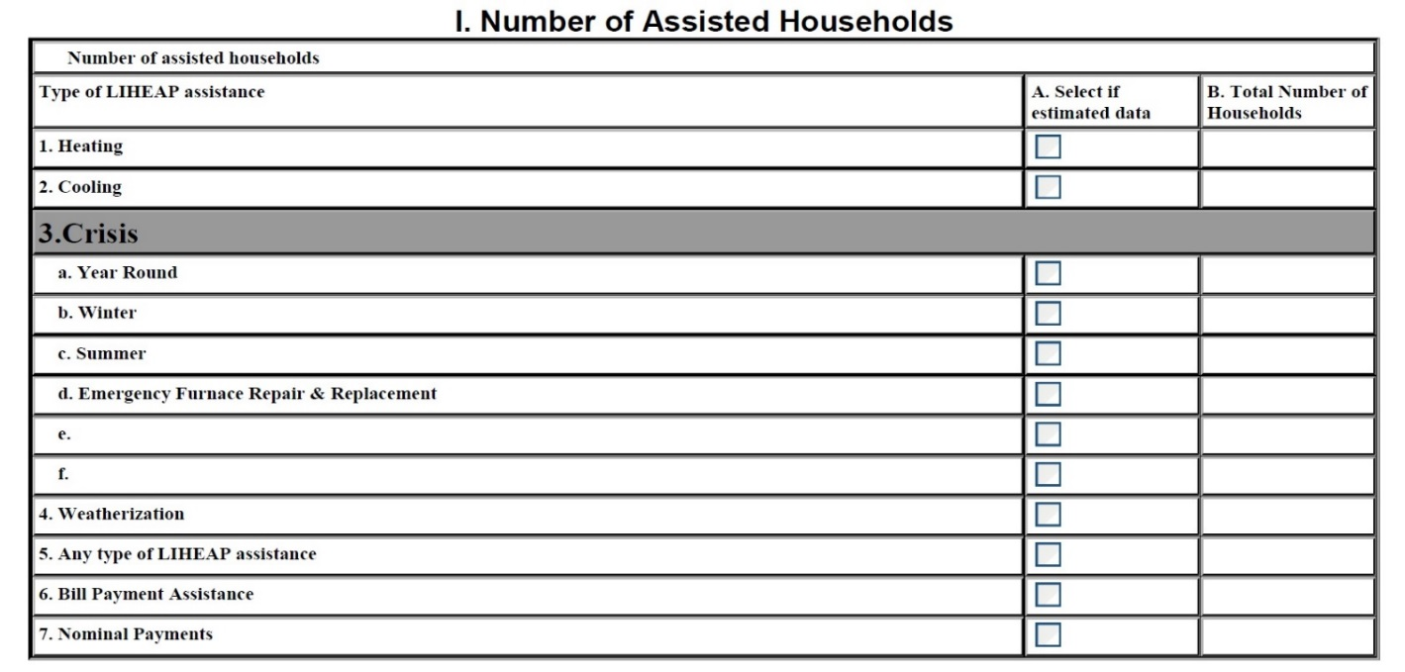
Line #1 – Heating Assistance
Presenter(s):
Dan Bausch

Slide 24
Topic #1 – Heating Assistance
What benefits are counted?
Which households should be reported as receiving a Heating Assistance benefit?
  Any household that received LIHEAP assistance to pay a share of a household’s heating bills using funds allocated for regular Heating Assistance.
For some states, Heating Assistance may also include:
  Households that received expedited heating assistance (more on slide 26)
  Households that received heating equipment repair/replacement on a non-emergency basis (more on slide 29)
Presenter(s):
Dan Bausch

Slide 25
Topic #1 – Heating Assistance
What is the reporting period?
Households that received Heating Assistance during what time period should be included in the Household Report?
  Report households that received Heating Assistance during the fiscal year (October 1, 2017 – September 30, 2018)
Grantees may operate their programs on a different program year (e.g., starting January 1 or July 1), but the data used to complete the Household Report should be data for the fiscal year.
Presenter(s):
Dan Bausch

Slide 26

Topic #1 – Heating Assistance
Expedited Heating Assistance
If grantees do not have a separate crisis component and separate crisis funds, but do provide expedited heating assistance to households in a crisis situation, should these households be reported under Heating Assistance?
  Yes, report households served with expedited heating assistance under both Heating Assistance and Crisis Assistance.
Include a note that explains you do not have a separate crisis program and that states the number of households that were provided with expedited heating assistance.
Confirm reporting is consistent with how your crisis program is characterized in your Model Plan (Fast Track should be checked in Field 4.8).

Slide 27
Topic #1 – Heating Assistance
What if households received multiple benefits?
How should a household be reported if it received multiple heating benefits during the fiscal year?
  Report an unduplicated count of households that received Heating Assistance.
Definition: Unduplicated Count – an item, such as a household, is counted only once for a specific data element.
Example on next slide
Presenter(s):
Dan Bausch

Slide 28
Topic #1 – Heating Assistance
Unduplicated Count Example
Household Scenarios | Number of Assisted Households by Type of LIHEAP Assistance
 | Heating | Cooling | Year Round Crisis | Winter Crisis | Summer Crisis | Other Crisis | Wxz.
Household A receives three heating assistance benefits and one year round crisis assistance benefit. | 3 | 0 | 1 | 0 | 0 | 0 | 0
Household B receives a heating assistance benefit, a cooling assistance benefit, and weatherization assistance. | 1 | 1 | 0 | 0 | 0 | 0 | 1
Household C receives a winter crisis benefit, emergency replacement of its heating unit, and summer crisis assistance benefit. | 0 | 0 | 0 | 1 | 1 | 1 | 0
Household D receives an “expedited” or “fast tracked” heating assistance benefit to avoid a utility shutoff. | 1 | 0 | 0 | 1 | 0 | 0 | 0
Household E receives “fast tracked” heating assistance, regular cooling assistance, summer crisis assistance, replacement of an air conditioner, and weatherization assistance. | 1 | 1 | 0 | 1 | 1 | 1 | 1
Unduplicated Number of Households for EACH Type of LIHEAP Assistance | 4 | 2 | 1 | 3 | 2 | 2 | 2
Unduplicated Number of Households for ANY Type of LIHEAP Assistance | 5

Slide 29
Topic #1 – Heating Assistance
Non-Emergency Equipment Repair and Replacement
Most grantees pay for heating equipment repair and replacement through their crisis program on an emergency basis or through their weatherization program on a non-emergency basis.
  However, some grantees report households that received heating equipment repair/replacement under Heating Assistance if this was done on a non-emergency basis and paid for with heating assistance funds.
  If a household received a regular heating benefit AND equipment repair/replacement using heating funds, the household should only be reported once under Heating Assistance.
Include a note indicating the number of households that received only non-emergency repair or replacement using heating funds.
Include a note indicating the number of households that received non-emergency repair or replacement and a regular Heating Assistance benefit.
Presenter(s):
Dan Bausch

Slide 30
Topic #1 – Heating Assistance
Households Served with Prior Year Funds
If a household was served in the current fiscal year with Heating Assistance using prior year funds, should the household be included in the Household Report?
  Yes, report the number of households served during the fiscal year, even if using funds obligated by the state in the prior year.
Grantees should add a note that explains the funding that was used from the previous year and the number of households that were served with this funding.
Presenter(s):
Dan Bausch

Slide 31
Topic #1 – Heating Assistance
Households Served Using LIHEAP & Other Funds
Should households that received a heating benefit that is only partially paid for with LIHEAP funds be reported in the Household Report?
  Yes, if a household was assisted with any LIHEAP dollars, it should be included in the Household Report.
  If a household was assisted with no LIHEAP dollars, it should not be included in the Household Report.
Presenter(s):
Dan Bausch

Slide 32
Topic #1 – Heating Assistance
Reporting Actual Data in the Final Report
Can the Household Report contain estimated data?
  While grantees can submit estimated data in the preliminary Household Report, actual data must be submitted for the final Household Report.
Once all data in the Household Report are final, select “no” in response to the question in the Instructions Section: “Do the data below include estimated figures?” and uncheck any estimated data checkboxes.
The final Household Report with actual data is expected to be due in OLDC in December.
Presenter(s):
Dan Bausch

Slide 33
Line #2 – Cooling Assistance
Presenter(s):
Grace Rehaut

Slide 34
Topic #1 – Cooling Assistance
What benefits are counted?
Which households should be reported as receiving a Cooling Assistance benefit?
  Any household that received LIHEAP assistance to pay a share of a household’s cooling bills using funds allocated for regular Cooling Assistance.
For some states, Cooling Assistance may also include households that received cooling equipment repair/replacement on a non-emergency basis.
Presenter(s):
Grace Rehaut

Slide 35
Topic #1 – Cooling Assistance
Consistency with Model Plan
If your Model Plan indicates you have a cooling program, should households be reported in the Household Report?
  Yes, if a grantee has a cooling program, households should be reported under Cooling Assistance.
If grantees do operate a cooling program but did not serve any households with Cooling Assistance during the fiscal year, add a note to explain why no households were served with Cooling Assistance.
Presenter(s):
Grace Rehaut

Slide 36
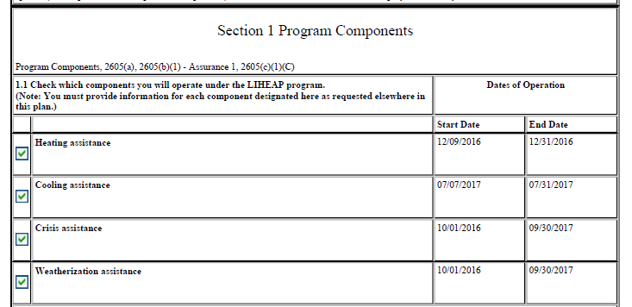

Topic #1 – Cooling Assistance
Consistency with Model Plan

Slide 37
Topic #1 – Cooling Assistance
Reminders from Heating Assistance Reporting
Several reporting requirements and guidelines were covered in the previous section about Heating Assistance, and some of these topics also apply to Cooling Assistance. Please refer back to the listed slides to review information on the following topics. The guidance found in these slides should also be followed when reporting Cooling Assistance in Line 2.
  Reporting Period (Slide 25)
  Unduplicated Count (Slides 27 and 28)
  Non-Emergency Equipment Repair & Replacement (Slide 29)
  Households Served with Prior Year Funds (Slide 30)
  Households Served Using LIHEAP and Other Funds (Slide 31)
  Reporting Actual Data in the Final Report (Slide 32)
Presenter(s):
Grace Rehaut

Slide 38
Lines #3a-f – Crisis Assistance
Presenter(s):
Dan Bausch

Slide 39
Topic #1 – Crisis Assistance
What are the different types of Crisis Assistance?
What is Crisis Assistance?
  A type of LIHEAP assistance that is provided in under 48 hours after a request for assistance. Grantees set their own criteria for Crisis Assistance, defined in their Model Plans. Crisis reporting in the Household Report should be consistent with the Model Plan.
Five categories of Crisis Assistance can be reported in the Household Report form:
  Year Round Crisis
  Winter Crisis
  Summer Crisis
  Emergency Furnace Repair & Replacement
  Other Crisis Assistance
Presenter(s):
Dan Bausch

Slide 40
Topic #1 – Crisis Assistance
What if another agency administers this?
  Some grantees may not directly capture information about crisis assistance in their primary LIHEAP data tracking systems.
  In this situation, Grantees do need to obtain household-level data from their subgrantees or program partners who record this information. Grantees need this to identify which households received other types of LIHEAP assistance in order to calculate and report the count of households that received “Any Type of LIHEAP Assistance” (Line 5 of Section I) .
      This also means a unique ID is needed to match households that received Crisis Assistance to households that received other types of LIHEAP assistance.
  Please contact APPRISE if you need assistance with this.
Presenter(s):
Dan Bausch

Slide 41
Topic #1 – Year Round Crisis Assistance
What benefits are counted?
Which households should be reported as receiving Year Round Crisis Assistance?
  Any household that received Year Round Crisis Assistance according to the criteria defined by the grantee in their Model Plan.
  Typically includes crisis assistance that is provided throughout the year, rather than seasonally.
  For expedited or “fast track” heating assistance in a crisis situation, see slide 26.
Examples of Year Round Crisis Assistance could include:
  Bill Payment assistance after disconnection/disconnect notice
  Emergency fuel delivery after running out of fuel or due to imminent risk of running out of fuel
Presenter(s):
Dan Bausch

Slide 42
Topic #1 – Winter Crisis Assistance
What benefits are counted?
Which households should be reported as receiving Winter Crisis Assistance?
  Any household that received Winter Crisis Assistance according to the criteria defined by the grantee in their Model Plan.
  Typically includes crisis assistance provided under the same timeline as a state’s heating assistance program.
  For expedited or “fast track” heating assistance in a crisis situation, see slide 26.
Examples of Winter Crisis Assistance could include:
  Bill Payment assistance after disconnection/disconnect notice
  Emergency fuel delivery after running out of fuel or due to imminent risk of running out of fuel
Presenter(s):
Dan Bausch

Slide 43
Topic #1 – Summer Crisis Assistance
What benefits are counted?
Which households should be reported as receiving Summer Crisis Assistance?
  Any household that received Summer Crisis Assistance according to the criteria defined by the grantee in their Model Plan.
  Typically includes crisis assistance provided under the same timeline as a state’s cooling assistance program.
Examples of Summer Crisis Assistance could include:
  Bill Payment assistance after disconnection/disconnect notice
Presenter(s):
Dan Bausch

Slide 44
Topic #1 – Emergency Furnace Repair & Replacement
Which households are counted?
Which households should be reported as receiving Emergency Furnace Repair & Replacement?
  Any household that received emergency home energy equipment repair or replacement using crisis funds.
  This includes repairing broken and inoperable home energy equipment (furnaces, HVAC systems, etc.) within 48 hours.
This should be reflected in the Model Plan (check “Yes” next to Field 4.14 “Do you provide for equipment repair or replacement using crisis funds?”)
Presenter(s):
Dan Bausch

Slide 45
Topic #1 – Other Crisis Assistance
What is Other Crisis Assistance?
When should grantees report households served with Other Crisis Assistance?
  Report households served with Other Crisis Assistance when grantees run “Other Crisis Assistance” programs beyond Winter Crisis, Summer Crisis, Year Round Crisis, or Emergency Furnace Repair & Replacement programs.
  These should not include bill payment assistance or emergency equipment repair and replacement.
Examples include:
  Purchase or loan of space heaters
  Providing blankets
  Payment of reconnection
Presenter(s):
Dan Bausch

Slide 46
Topic #1 – Other Crisis Assistance
How should Other Crisis Assistance be reported?
Where do I report “Other Crisis Assistance”
  Report the number of assisted households in an empty line on the form (line 3e and 3f) and clearly label the line with the “Other Crisis Assistance.”
Presenter(s):
Dan Bausch

Slide 47
Topic #1 – Other Crisis Assistance
How should Other Crisis Assistance be reported?
In addition to reporting them on empty lines…
  ADD those households that received "other crisis assistance" to year-round, winter, or summer crisis fuel assistance if they represent additional households excluded from the crisis assistance data. Also include poverty data and vulnerable household data.
  DO NOT ADD those households that received "other crisis assistance” to year-round, winter, or summer crisis assistance if they already received year-round, winter, or summer crisis assistance so as to avoid duplicating the household count
Include a note that indicates how many of these households are included in the crisis data and the nature of the assistance.
Presenter(s):
Dan Bausch

Slide 48
Topic #1 – Crisis Assistance
Reminders from Heating Assistance Reporting
Several reporting requirements and guidelines were covered in the first section about Heating Assistance, and some of these topics also apply to Crisis Assistance. Please refer back to the listed slides to review information on the following topics. The guidance found in these slides should also be followed when reporting Crisis Assistance in Lines 3(a-f).
  Reporting Period (Slide 25)
  Expedited Heating Assistance (Slide 26)
  Unduplicated Count (Slides 27 and 28)
  Households Served with Prior Year Funds (Slide 30)
  Households Served Using LIHEAP and Other Funds (Slide 31)
  Reporting Actual Data in the Final Report (Slide 32)
Presenter(s):
Dan Bausch

Slide 49
Line #4 – Weatherization Assistance
Presenter(s):
Grace Rehaut

Slide 50
Topic #1 – Weatherization Assistance
Which households are counted?
Which households should be reported as receiving Weatherization Assistance?
  Any household that received low-cost residential weatherization and other energy-related home repair with LIHEAP funds.
LIHEAP Weatherization can be administered:
  Entirely under LIHEAP rules
  Entirely under DOE WAP rules
  Mostly under LIHEAP rules, with some DOE WAP rules
  Mostly under DOE WAP rules, with some LIHEAP rules
Grantees may only use 15% of their LIHEAP funds for Weatherization Assistance, unless a waiver from HHS to increase the percentage to 25% is requested and approved.
Presenter(s):
Grace Rehaut

Slide 51
Topic #1 – Weatherization Assistance
What if another agency administers this?
  Some grantees may not directly capture information about weatherization assistance in their primary LIHEAP data tracking systems.
  Grantees in this situation do need to obtain household-level data from their subgrantees or program partners who record this information. Grantees need this to identify which households received other types of LIHEAP assistance in order to calculate and report the count of households that received “Any Type of LIHEAP Assistance” (Line 5 of Section I) .
      This also means a unique ID is needed to match households that received Weatherization Assistance to households that received other types of LIHEAP assistance.
  Please contact APPRISE if you need assistance with this.
Presenter(s):
Grace Rehaut

Slide 52
Topic #1 – Weatherization Assistance
Consistency with Model Plan
If your Model Plan indicates providing Weatherization Assistance, should households be reported in the Household Report?
  Yes, if a grantee runs a weatherization program, households should be reported under Weatherization Assistance.
If grantees do operate a weatherization program but did not serve any households with Weatherization Assistance during the fiscal year, add a note to explain why no households were served with Weatherization Assistance.
Presenter(s):
Grace Rehaut

Slide 53
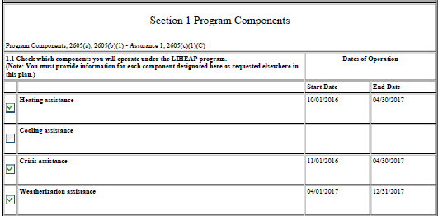

Topic #1 – Weatherization Assistance
Consistency with Model Plan

Slide 54
Topic #1 – Weatherization Assistance
Equipment Repair and Replacement
If equipment repair and replacement is provided using weatherization funds, where should households that received these services be reported?
  Report these households under Weatherization Assistance if weatherization funds were used.
Presenter(s):
Grace Rehaut

Slide 55
Topic #1 – Weatherization Assistance
Reminders from Heating Assistance Reporting
Several reporting requirements and guidelines were covered in the first section about Heating Assistance, and some of these topics also apply to Weatherization Assistance. Please refer back to the listed slides to review information on the following topics. The guidance found in these slides should also be followed when reporting Weatherization Assistance in Line 4.
  Reporting Period (Slide 25)
  Unduplicated Count (Slides 27 and 28)
  Households Served with Prior Year Funds (Slide 30)
  Households Served Using LIHEAP and Other Funds (Slide 31)
  Reporting Actual Data in the Final Report (Slide 32)
Presenter(s):
Grace Rehaut

Slide 56
Line #5 – Any Type of LIHEAP Assistance
Presenter(s):
Dan Bausch

Slide 57
Topic #1 – Any Type of LIHEAP Assistance
How is Any Type of LIHEAP Assistance calculated?
How should the number of households that received Any Type of LIHEAP Assistance be reported?
  Report an unduplicated count of households that received any type of LIHEAP Assistance.
  Count a household that received at least one type of LIHEAP assistance, regardless of the type(s) of assistance provided to the household, only once.
Example on next slide
Presenter(s):
Dan Bausch

Slide 58
Topic #1 – Any Type of LIHEAP Assistance
Unduplicated Count Example
Household Scenarios | Number of Assisted Households by Type of LIHEAP Assistance
 | Heating | Cooling | Year Round Crisis | Winter Crisis | Summer Crisis | Other Crisis | Wxz.
Household A receives three heating assistance benefits and one year round crisis assistance benefit. | 3 | 0 | 1 | 0 | 0 | 0 | 0
Household B receives a heating assistance benefit, a cooling assistance benefit, and weatherization assistance. | 1 | 1 | 0 | 0 | 0 | 0 | 1
Household C receives a winter crisis benefit, emergency replacement of its heating unit, and summer crisis assistance benefit. | 0 | 0 | 0 | 1 | 1 | 1 | 0
Household D receives an “expedited” or “fast tracked” heating assistance benefit to avoid a utility shutoff. | 1 | 0 | 0 | 1 | 0 | 0 | 0
Household E receives “fast tracked” heating assistance, regular cooling assistance, summer crisis assistance, replacement of an air conditioner, and weatherization assistance. | 1 | 1 | 0 | 1 | 1 | 1 | 1
Unduplicated Number of Households for EACH Type of LIHEAP Assistance | 4 | 2 | 1 | 3 | 2 | 2 | 2
Unduplicated Number of Households for ANY Type of LIHEAP Assistance | 5

Slide 59
Topic #1 – Any Type of LIHEAP Assistance
What are general guidelines for reporting?
What are general guidelines when reporting households served with Any Type of LIHEAP Assistance?
  Confirm that you have no duplicate clients to count each household only once.
  The number reported in Any Type of LIHEAP Assistance should be greater than the number of households reported for each type of assistance (unless households must receive one type of assistance before receiving any other type of assistance).
  The number reported in Any Type of LIHEAP Assistance should be less than the sum of households reported for each type of assistance (unless households can only receive one type of assistance per year).
Presenter(s):
Dan Bausch

Slide 60
Line #6 – Bill Payment Assistance
Presenter(s):
Dan Bausch

Slide 61
Topic #1 – Bill Payment Assistance
What is Bill Payment Assistance?
Which households received Bill Payment Assistance?
  Any household provided with a LIHEAP benefit used to pay a share of a household’s energy bills and utility deposits.
This should include:
  Households receiving heating, cooling, and crisis assistance benefits to pay a share of a household’s energy bills or utility deposits.
  Households receiving Heat-in-Rent payments.
This should exclude:
  Households receiving only LIHEAP weatherization assistance or energy-related equipment repair or replacement services.
  SNAP households that only received a nominal LIHEAP benefit (if applicable).
Presenter(s):
Dan Bausch

Slide 62
Topic #1 – Bill Payment Assistance
What are general guidelines for reporting?
What are some general guidelines when reporting households served with Bill Payment Assistance?
  Report an unduplicated count of households that received any type of bill payment assistance.
  Many grantees allow households to receive more than one type of LIHEAP bill payment assistance, such as receiving both Crisis Assistance and Heating Assistance.
    If that is the case, then the unduplicated count of bill payment assistance households should be less than the sum of the household counts for each separate assistance type.
Presenter(s):
Dan Bausch

Slide 63
Topic #1 – Bill Payment Assistance
What are general guidelines for reporting?
What are some general guidelines when reporting households served with Bill Payment Assistance?
  Report an unduplicated count of households that received any type of bill payment assistance.
  Many grantees provide weatherization or equipment repair/replacement through LIHEAP.
    If that is the case, then the unduplicated count of bill payment assistance households should be less than or equal to the total unduplicated count for any type of LIHEAP assistance (Section I, Line 5).
Presenter(s):
Dan Bausch

Slide 64


Topic #1 – Bill Payment Assistance
Connection to Performance Data Form
  The number you report should be the same as Section V Part A of your FY 2018 Performance Data Form.
Household Report
Performance Data Form – Module 2 Section V – Part A

Slide 65
Line #7 – Nominal Payments
Presenter(s):
Dan Bausch

Slide 66
Topic #1 – Nominal Payments
What are Nominal Payments?
Which households received Nominal Payments?
  Any household that received nominal LIHEAP benefits as part of a partnership with the Supplemental Nutrition Assistance Program (SNAP). The minimum benefit amount is $20.01.
Only the few states that have a separate LIHEAP payment amount for SNAP recipient households need to report these households.
This is often referred to as "Heat or Eat" or "Cool or Eat" Program.
Presenter(s):
Dan Bausch

Slide 67
Topic #1 – Nominal Payments
What are general guidelines for reporting?
What are general guidelines when reporting households that received Nominal Payments?
  Report the SNAP households that received a nominal LIHEAP benefit.
  Provide a note that includes the number of households served, a program description, and the benefit amount.
  Do NOT include households that received nominal benefits in the reported number of households that received “Any Type of Assistance.”
  States that provide nominal benefits must indicate that they provide nominal benefits in their Model Plans (Field 1.7a).
Presenter(s):
Dan Bausch

Slide 68
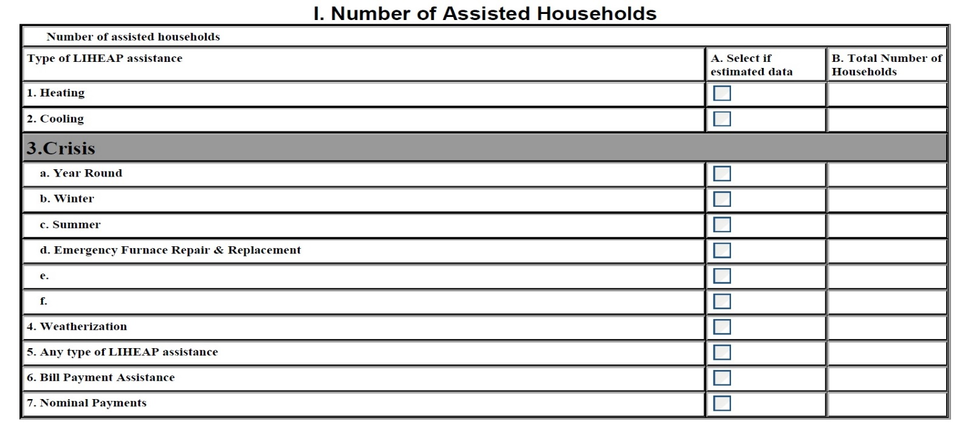
Topic #1 – Nominal Payments
Reporting Example?
1
NYS issued a $21 nominal “Heat & Eat” benefit to 1 household in FY 2018
Presenter(s):
Dan Bausch

Slide 69
Topic #1 – Reporting Reminder
Reporting Unduplicated Counts
  Grantees should report an unduplicated count for each data element.
  If a household received multiple benefits for the same type of assistance…
      That households is only counted once when reporting the count of households that received that type of assistance.
  If a household receives more than one time of assistance…
      That household should be included in the unduplicated count for each type of assistance.
  When you are calculating the number of households that received Bill Payment Assistance or Any Type of LIHEAP Assistance…
      Each household should only be counted once.
Presenter(s):
Dan Bausch

Slide 70
Topic #1 – Questions
Grantee Questions regarding Section I of the Household Report Form?

Slide 71
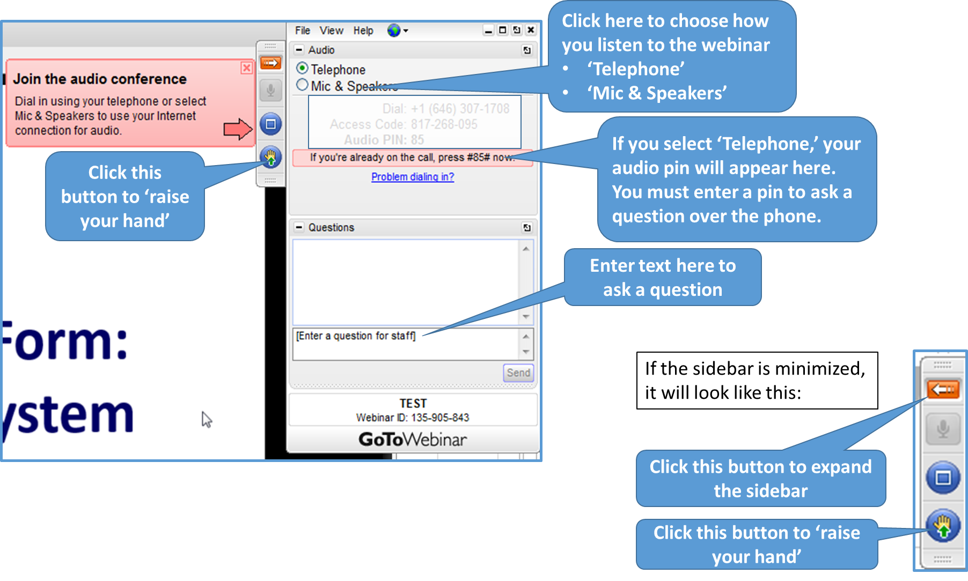
GoToWebinar – Asking a Question
If you wish to call in and ask a question, you MUST call in by phone rather than connect your audio through your computer

Slide 72
Section II:
Number of Assisted Households by Poverty Interval

Slide 73
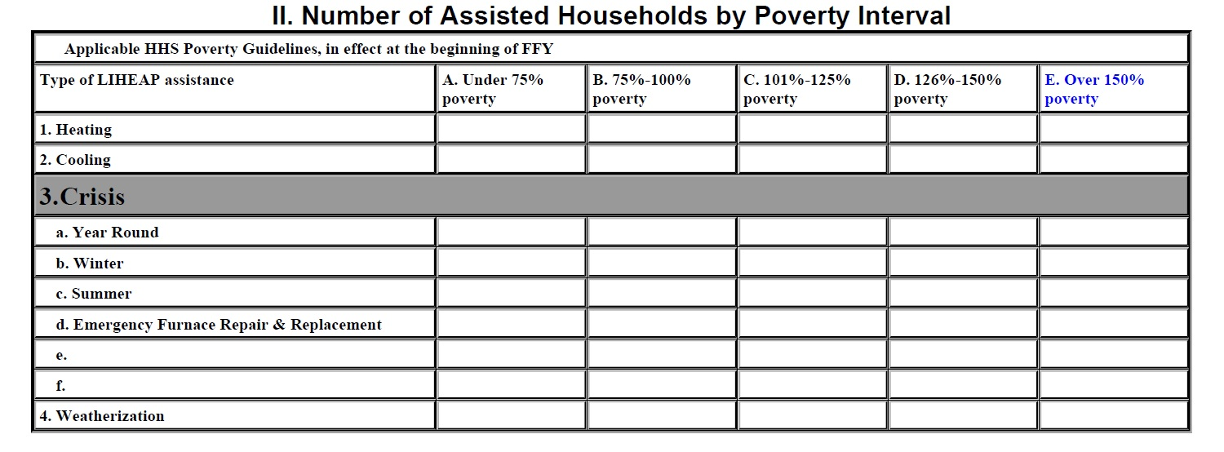
Topic #2 – Section II
Presenter(s):
Grace Rehaut

Slide 74
Topic #2 – Section II Reporting Requirements
What information is required?
What information is reported in Section II?
  Provide an unduplicated count of assisted households by poverty interval for Heating, Cooling, Crisis, and Weatherization Assistance.
Grantees must report the number of assisted households by poverty interval for each type of assistance reported in Section I.
The sum of households reported by poverty interval in Section II for each type of assistance should equal the total households reported for each type of assistance in Section I.
  Example on next slide
Grantees should confirm reporting is consistent with the income threshold defined in their State Plans.
Presenter(s):
Grace Rehaut

Slide 75





Topic #2 – Section II Reporting Requirements
Sum of Poverty Intervals – Example
From Section I
Presenter(s):
Grace Rehaut

Slide 76
Topic #2 – Section II Reporting Requirements
How was income eligibility determined?
How did grantees determine which households were eligible for LIHEAP assistance?
  When determining eligibility for FY 2018, grantees had a few options:
    Use the FY 2017 HHS Poverty Guidelines.
    Use the FY 2018 State Median Income (SMI).
    If a program component began after the start of the calendar year, use the FY 2018 HHS Poverty Guidelines.
    Switch to the FY 2018 HHS Poverty Guidelines when these guidelines came into effect (mid-year).
Presenter(s):
Dan Bausch

Slide 77
Topic #2 – Section II Reporting Requirements
Which income guidelines are used for reporting?
Since grantees can use different income guidelines in determining eligibility, how should households be reported in Section II?
  Report households in Section II according to the income standard used at the beginning of the fiscal year: the 2017 HHS Poverty Guidelines
  They are available here: https://www.acf.hhs.gov/ocs/resource/liheap-im-2017-02-fy-2017-hhs-federal-poverty-guidelines
If grantees changed the income guidelines they were using mid-year (i.e. used FY 2018 HHS PG after they came into effect rather than use FY 2017 HHS PG), grantees might serve some households over the original income threshold indicated in their Model Plan.
If some households are over the income threshold indicated in your Model Plan for this reason, add a note explaining this.
Presenter(s):
Dan Bausch

Slide 78
Topic #2 – Section II Reporting Requirements
Steps to Assign each Household to a Poverty Interval
4-step process:
  For each household you assist with LIHEAP…
    Collect the household's gross income.
    Collect the number of members in that household.
  If the income amount you collect represents less than one year, convert the gross income to be annual gross income.
  Divide the assisted household's gross income by the dollar amount equal to 100% of the 2017 HHS Poverty Guidelines for that household size.
  Multiply the result by 100 and round to the nearest whole number percent.
Presenter(s):
Dan Bausch

Slide 79
Topic #2 – Section II Reporting Requirements
Example of how to assign Poverty Interval
A household in Arizona received heating assistance in FY 2018.
The annual gross income was $26,549.
The number of members in that household was three.
According to the 2017 HHS Poverty Guidelines for Arizona, $20,420 represents 100% of the HHS Poverty Guidelines for a three-person household.
Divide the household’s income of $26,539 by $20,420. The result is 1.2997.
Multiply by 100 = 129.97%
Rounding off to the nearest whole percent = 130% of the 2017 HHS Poverty Guidelines.
That household is classified as being within the interval of “126% -150% poverty” for heating assistance.
Presenter(s):
Dan Bausch

Slide 80
Topic #2 – Section II Reporting Requirements
Reporting Households with Missing Income
In general, there should not be households missing income information.
In rare instances when income information is missing, follow the guidance below:
  Report these households in the highest poverty interval in Section II. Missing income information must be reported so the sum of households reported by poverty interval in Section II equals the total households reported in Section I.
  Add a note explaining the number of households that were missing income information, what type of assistance these households received, and the poverty interval these households were included in.
Presenter(s):
Dan Bausch

Slide 81
Topic #2 – Questions
Grantee Questions regarding Section II of the Household Report Form?

Slide 82
GoToWebinar – Asking a Question
If you wish to call in and ask a question, you MUST call in by phone rather than connect your audio through your computer

Slide 83
Section III:
Number of Assisted Households by Vulnerable Population

Slide 84
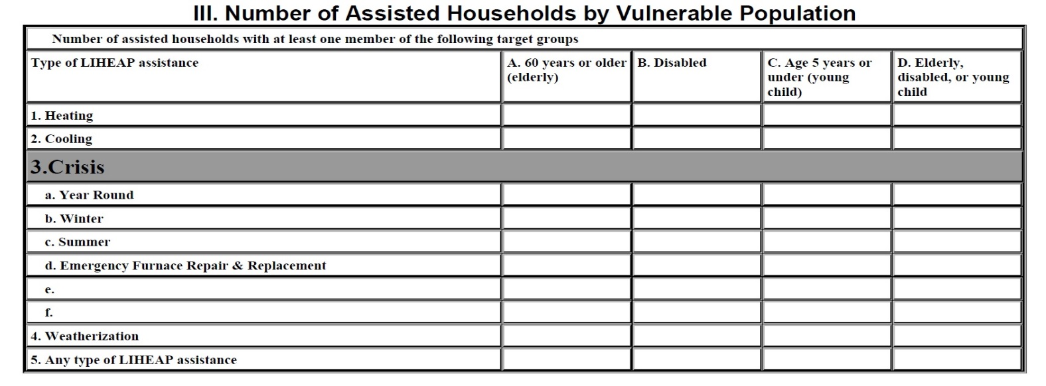
Topic #3 – Section III
Presenter(s):
Grace Rehaut

Slide 85
Topic #3 – Section III Reporting Requirements
Vulnerable Households
Which households are considered vulnerable households?
  The LIHEAP Statute specifies three separate vulnerability groups
    Households with one or more elderly members
    Households with one or more disabled members
    Households with one or more young children
Presenter(s):
Grace Rehaut

Slide 86
Topic #3 – Section III Reporting Requirements
Definitions of Vulnerable Households
How are vulnerable groups defined?
  Elderly is defined as a person 60 years or older
  Young child is defined as a person age 5 years or under
  A disabled household member is not defined by the LIHEAP Statute. States decide who they will count as disabled members based on their own definitions
    Examples include:
      Members with a permanent disability
      Members receiving disability insurance
Presenter(s):
Grace Rehaut

Slide 87
Topic #3 – Section III Reporting Requirements
Identifying Vulnerable Households
What do I need to identify households with vulnerable members?
  Collect information as part of the application/intake process
  Store data in your data management system
  Create an indicator field for each vulnerable member type to mark whether or not a household contains a vulnerable member.
  Create an indicator field to mark whether a household contains any of the three vulnerable member types.
Presenter(s):
Grace Rehaut

Slide 88
Topic #3 – Section III Reporting Requirements
What information is required?
What information is reported in Section III?
  Provide an unduplicated count of assisted households by vulnerable population for Heating, Cooling, Crisis, Weatherization, and Any Type of LIHEAP Assistance.
  A household is counted if ANY member meets the vulnerable population definition.
Grantees should report the number of assisted households by vulnerable population for each type of assistance reported in Section I.
In general, the households reported in Section III for each type of assistance should be a subset of the households reported in Section I (unless a grantee allows only households with a vulnerable member to receive a type of assistance).
Presenter(s):
Dan Bausch

Slide 89
Topic #3 – Section III Reporting Requirements
Households with At Least One Vulnerable Member
Presenter(s):
Dan Bausch

Slide 90
Topic #3 – Section III Reporting Requirements
Notes on Reporting Unduplicated Counts
What are general guidelines when reporting unduplicated counts in Section III, Column D?
  In Column D, “Elderly, Disabled, or Young Child”, report an unduplicated count for each type of assistance with at least one vulnerable member.
  You should NOT simply add Elderly + Disabled + Young Child to produce the number of households with an “Elderly, Disabled, or Young Child” member
  This value should capture the total number of households for each type of assistance with one or more vulnerable members.
  This should be less than the sum of elderly, disabled, and young child households for each type of assistance.
Presenter(s):
Dan Bausch

Slide 91



Topic #3 – Section III Reporting Requirements
Households with At Least One Vulnerable Member – Example
Example:
  1 household has an elderly member and a disabled member
  1 household has a disabled member and a young child
  1 household only has an elderly member
  1 household only has a disabled member
Presenter(s):
Dan Bausch

Slide 92
Topic #3 – Section III Reporting Requirements
Any Type of LIHEAP Assistance by Vulnerability
Presenter(s):
Dan Bausch

Slide 93
Topic #3 – Section III Reporting Requirements
Notes on Reporting Unduplicated Counts
What are general guidelines when reporting unduplicated counts in Section III, Line 5?
  In Line 5, report an unduplicated count of households that received Any Type of LIHEAP Assistance by vulnerable category.
  The same guidelines for reporting Any Type of LIHEAP Assistance in Section I apply to reporting Any Type of LIHEAP Assistance in Section III. Refer to Slide 57 to review this guidance.
  The number reported in Any Type of LIHEAP Assistance in Section III should be less than the number reported in Any Type of LIHEAP Assistance in Section I.
Presenter(s):
Dan Bausch

Slide 94
Topic #3 – Questions
Grantee Questions regarding Section III of the Household Report Form?

Slide 95
GoToWebinar – Asking a Question
If you wish to call in and ask a question, you MUST call in by phone rather than connect your audio through your computer

Slide 96
Section IV:
Number of Applicant Households

Slide 97
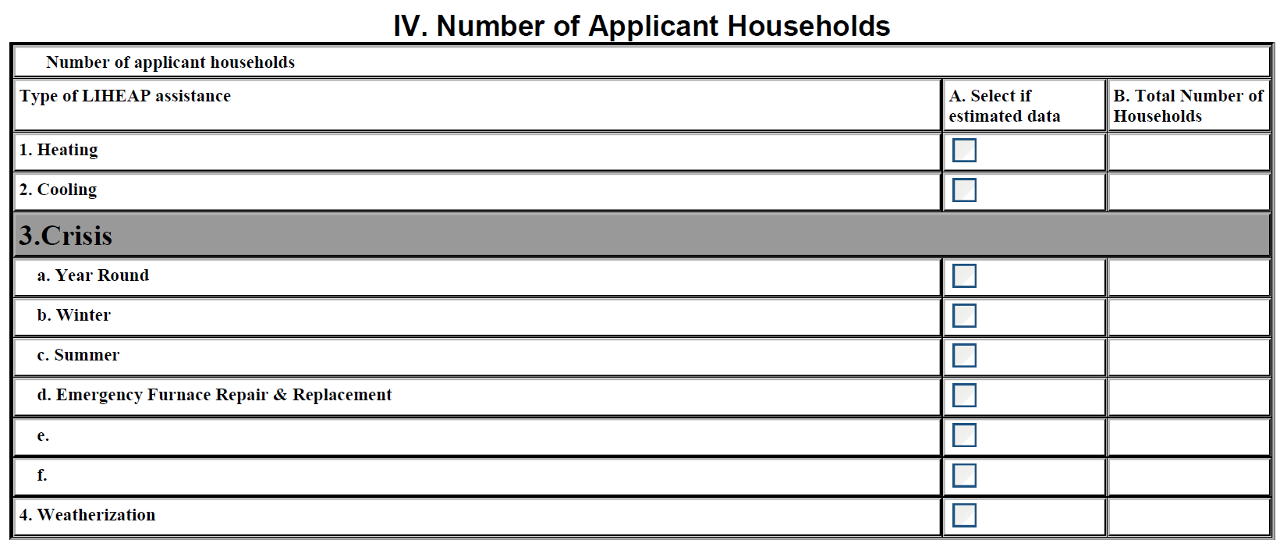
Topic #4 – Section IV
Presenter(s):
Grace Rehaut

Slide 98
Topic #4 – Applicant Households
Which households are applicant households?
Which households are considered applicant households?
  The definition of applicant households is left to each LIHEAP grantee, as the LIHEAP statute does not define the term.
  Grantees should report applicant households according to their definitions.
  Examples include:
    Households that submit an application for assistance during the fiscal year.
    Households that visit an agency to apply.
Presenter(s):
Grace Rehaut

Slide 99
Topic #4 – Applicant Households
What is the reporting period?
Households that applied during what time period should be included in Section IV of the Household Report?
  Report households that applied during the fiscal year (October 1, 2017 – September 30, 2018)
Grantees may operate their programs on a different program year (e.g., starting January 1 or July 1), but the data used to complete the Household Report should be data for the fiscal year.
Presenter(s):
Grace Rehaut

Slide 100
Topic #4 – Applicant Households
What information is required?
What information is reported in Section III?
  Provide an unduplicated count of households that applied for each type of LIHEAP assistance, regardless of if they actually received the assistance.
Grantees should report the number of applicant households for each type of assistance reported in Section I.
Presenter(s):
Dan Bausch

Slide 101
Topic #4 – Applicant Households
Comparing Applicant and Assisted Households
How should the number of applicant households for each type of assistance compare to the number of assisted households for each type of assistance?
  In general, the number of applicant households reported for each type of assistance in Section IV should be greater than or equal to the number of assisted households reported for each type of assistance in Section I.
    If this is not the case, add a note explaining this.
Presenter(s):
Dan Bausch

Slide 102
Topic #4 – Applicant Households
Prior Year Applicants that Received Assistance
Should households that received assistance in FFY 2018, but applied in FFY 2017 be included in Section IV?
  No, only households that applied during the federal fiscal year (FFY 2018) should be included in Section IV.
If households that applied in the previous federal fiscal year received assistance during FFY 2018, the number of applicant households might be less than the number of assisted households.
If this is the case, add a note that explains the number of households that were assisted in the current fiscal year that applied in the previous year.
Presenter(s):
Dan Bausch

Slide 103
Topic #4 – Questions
Grantee Questions regarding Section IV of the Household Report Form?

Slide 104
GoToWebinar – Asking a Question
If you wish to call in and ask a question, you MUST call in by phone rather than connect your audio through your computer

Slide 105
Section V:
Number of Applicant Households by Poverty Interval

Slide 106
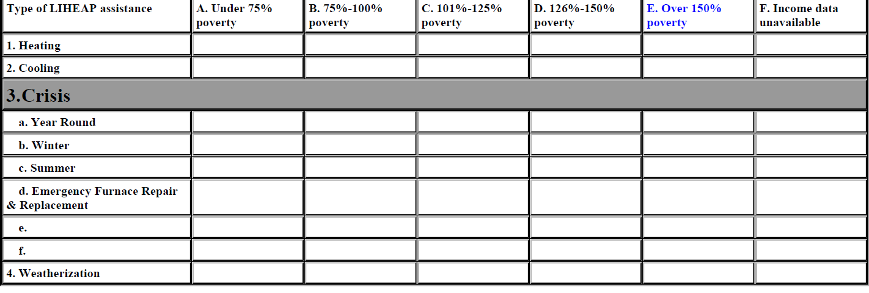
Topic #5 – Section V
Presenter(s):
Grace Rehaut

Slide 107
Topic #5 – Section V Reporting Requirements
What information is required?
What information is reported in Section V?
  Provide an unduplicated count of applicant households by poverty interval for Heating, Cooling, Crisis, and Weatherization Assistance.
Report the number of applicant households by poverty interval for each type of assistance reported in Section IV.
The sum of households reported by poverty interval in Section V for each type of assistance should equal the total households reported for each type of assistance in Section IV.
  Example on next slide
Presenter(s):
Grace Rehaut

Slide 108

Topic #5 – Section V Reporting Requirements
Sum of Poverty Intervals – Example
From Section IV
1
Presenter(s):
Grace Rehaut

Slide 109
Topic #5 – Section V Reporting Requirements
Which income guidelines are used for reporting?
Since grantees can use different income guidelines in determining eligibility throughout the fiscal year, how should households be reported in Section V?
  Report households in Section V according to the income standard used at the beginning of the fiscal year.
Presenter(s):
Dan Bausch

Slide 110
Topic #5 – Section V Reporting Requirements
Reporting Households with Missing Income
Are applicant households with missing income information reported in Section V?
  Yes, households missing income information should be reported in Column F, “Income data unavailable”
Again, confirm the sum of households reported by poverty interval in Section V for each type of assistance equals the total households reported for each type of assistance in Section IV.
Presenter(s):
Dan Bausch

Slide 111
Topic #5 – Section V Reporting Requirements
Comparing Applicant and Assisted Households
How should the number of applicant households by poverty level compare to the number of assisted households by poverty level?
  For each type of assistance, the applicant counts in each poverty level in Section V should be greater than or equal to the number of assisted households by poverty level reported in Section II.
    If this is not the case, add a note explain this.
Presenter(s):
Dan Bausch

Slide 112
Topic #5 – Questions
Grantee Questions regarding Section V of the Household Report Form?

Slide 113
GoToWebinar – Asking a Question
If you wish to call in and ask a question, you MUST call in by phone rather than connect your audio through your computer

Slide 114
Section VI:
Number of Assisted Households by Young Child Age Category (Optional)

Slide 115
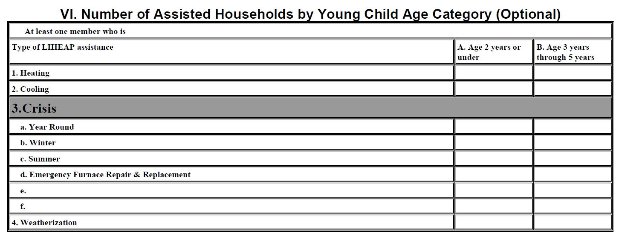
Topic #6 – Section VI
Presenter(s):
Grace Rehaut

Slide 116
Topic #6 – Section VI Reporting
Optional Data
Is completing Section VI required?
  No, Section VI is not required, and you can submit your final Household Report without completing Section VI.
Although Section VI is optional, it gives grantees the opportunity to provide more information about their program and the vulnerable population that is served.
Presenter(s):
Grace Rehaut

Slide 117
Topic #6 – Section VI Reporting
What information is reported?
What information is reported in Section VI?
  The number of assisted households with at least one child who is 2 years or under.
  The number of assisted households with at least one child who is between 3 years old and 5 years old.
Presenter(s):
Grace Rehaut

Slide 118
Topic #6 – Section VI Reporting
How should young child households be reported?
How are assisted households by young child category reported?
  Refer to Section III to count the assisted households with at least one child 5 years old or under for each type of assistance.
  Then, count the households with at least one child who is 2 years old or under.
  Then, count the households with at least one child who is between 3 years old and 5 years old, regardless of if the household was already counted as a household with at least one child 2 years old or under.
Presenter(s):
Dan Bausch

Slide 119
Topic #6 – Section VI Reporting
Section III and Section VI Comparison
How should the reported households for each young child category compare to the young child households reported in Section III?
  For each type of assistance, the sum of households with a Child Age 2 Years or Under and households with a Child Ages 3 Through 5 in Section VI should be greater than the number of households with a Child 5 Years or Younger in Section III.
  Example on next slide
Presenter(s):
Dan Bausch

Slide 120
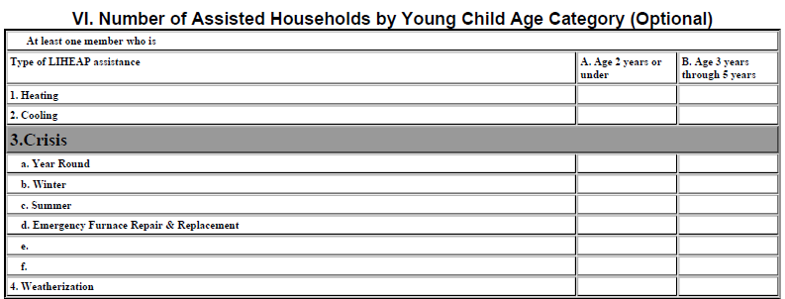
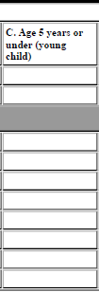
Topic #6 – Section VI Reporting
Section VI and Section III Comparison – Example
Example:
  The Gomez household has two children: a 1 year old and a 4 year old.
  The Johnson household has two children: a newborn and a 5 year old.
  The O’Shay household has one child that is 6 months old.
  The Kim household has one child that is 4 years old.
Presenter(s):
Dan Bausch

Slide 121
Topic #6 – Questions
Grantee Questions regarding Section VI of the Household Report Form?

Slide 122
GoToWebinar – Asking a Question
If you wish to call in and ask a question, you MUST call in by phone rather than connect your audio through your computer

Slide 123
Final Reminders

Slide 124
Final Reminders
FY 2018 Report Status
  Upon approval by OMB, HHS will publish an Action Transmittal with the final due date and instructions for accessing and submitting the form in OLDC.
  Grantees are encouraged to prepare their final data for submission in anticipation of a December due date.
  There are no changes to the FY 2018 Household Report. The requirements remain the same as those for last year’s FY 2017 Report.
Presenter(s):
Grace Rehaut

Slide 125
Final Reminders
Reporting in OLDC
The final Household Report is expected to be due in OLDC in December.
Remember that the Household Report must be:
  Entered in OLDC
  Saved in OLDC
  Certified by the appropriate person
  Submitted by the appropriate person
Presenter(s):
Grace Rehaut

Slide 126
Final Reminders
OLDC Warning and Error Messages
Several validation checks are programmed into OLDC, and a warning or error message will appear if a check fails.
  Warning Messages indicate data that may be correct, but require confirmation and additional explanation in the “Notes” section of the form.
  Fatal Error Messages indicate inconsistent data that must be corrected before grantees are able to submit their Household Report in OLDC.
Presenter(s):
Grace Rehaut

Slide 127
Final Reminders
Addressing Warnings and Fatal Errors
If a warning message appears, but you have an explanation for the warning (and have confirmed that the data is correct), add a note addressing the warning.
If a warning message appears and you do not know how to resolve it, contact APPRISE for assistance.
If a fatal error occurs and you do not know how to resolve it, contact APPRISE and we will work together to resolve the reporting issue.
Presenter(s):
Grace Rehaut

Slide 128
Final Reminders
Updating and Revising Report
After you submit your report…
  APPRISE will e-mail grantees to alert them to any issues or questions based on reviewing their submitted Household Report.
  Grantees should provide a response and make any corrections to their submitted report.
  When your report is confirmed to be complete, your liaison will accept your report in OLDC. Your final approved report information will be used for the LIHEAP Report to Congress.
If you later identify a correction or change is needed, you will need to submit a revision in OLDC.
Presenter(s):
Dan Bausch

Slide 129
Final Reminders
Household Report Resources
2017 HHS Poverty Guidelines to use for Poverty Intervals:
  https://www.acf.hhs.gov/ocs/resource/liheap-im-2017-02-fy-2017-hhs-federal-poverty-guidelines
FY 2017 Household Report Instructions:
  https://www.acf.hhs.gov/sites/default/files/ocs/liheap_at_2018_2_attachment_a_fy_17_hhrp_tinstructions_long_form.pdf
Past Years’ Household Report Data:
https://liheappm.acf.hhs.gov/data_warehouse/index.php?report=homepage
Presenter(s):
Dan Bausch

Slide 130
Final Reminders
Checking Your Report Prior to Submission
Make use of the LIHEAP Household Report “Check Before You Submit” Document
  Grantees should review all of the checks in the list, and if they can answer “Yes” to all of the questions in the list, they are ready to certify and submit the LIHEAP Household Report.
  Link to “Check Before You Submit” Document: https://liheappm.acf.hhs.gov/sites/default/files/private/grantee_tools/best_practices/Household-Report-Check-Before-You-Submit-Document.pdf
Review and address OLDC warning or error messages.
Presenter(s):
Dan Bausch

Slide 131
Final Reminders
OLDC Resources
OLDC is accessed through Grant Solutions.
Log-in to Grant Solutions at https://www.grantsolutions.gov/gs
Once logged in, click “OLDC” in the top taskbar to access the OLDC homepage.
If you need assistance, please contact Grants Center Of Excellence systems Help Desk:
  (202) 401-5282 or (866) 577-0771
  help@grantsolutions.gov
Presenter(s):
Dan Bausch

Slide 132
Final Reminders
Support Resources
OCS liaisons
  http://www.acf.hhs.gov/programs/ocs/resource/division-of-energy-assistance-federal-staff
Grants Center Of Excellence systems Help Desk
  help@grantsolutions.gov
  (202) 401-5282 or (866) 577-0771
APPRISE Team
    Daniel Bausch, Daniel-Bausch@appriseinc.org; 609-252-9050
    Jorge Mancilla, Jorge-MancillaUribe@appriseinc.org; 609-252-9009
    Grace Rehaut, Grace-Rehaut@appriseinc.org; 609-252-9052
    Julia Stadlinger, Julia-Stadlinger@appriseinc.org; 609-252-9057
    Melissa Torgerson, melissa@verveassociates.net; 503-706-2647
Presenter(s):
Dan Bausch

Slide 133
GoToWebinar – Asking a Question
If you wish to call in and ask a question, you MUST call in by phone rather than connect your audio through your computer

Slide 134
Questions & Answers
If we do not respond to your question during the webinar, we will follow-up via e-mail.
If you have additional questions, please e-mail us:
    Daniel Bausch, Daniel-Bausch@appriseinc.org
    Grace Rehaut, Grace-Rehaut@appriseinc.org
  Thank you for attending the webinar!

